Slide 1
How did black people suffer in labour industry (especially in multicultural country)
Present by: Khai

Slide 2
What happened?
Job Opportunity
Struggle During Work
Job Characteristics

Slide 3
Job Opportunity
White People | Black People
Job Interview is easy (mostly simple question) | Job Interview focused on hard question
Most likely to get a job if meet the requirement | Very high expectation, skills must beyond what it’s required
Can get to work immediately, with flexible schedule | Have to wait until further assess (if necessary), very fixed schedule

Slide 4


Struggle at Workplace

Slide 5
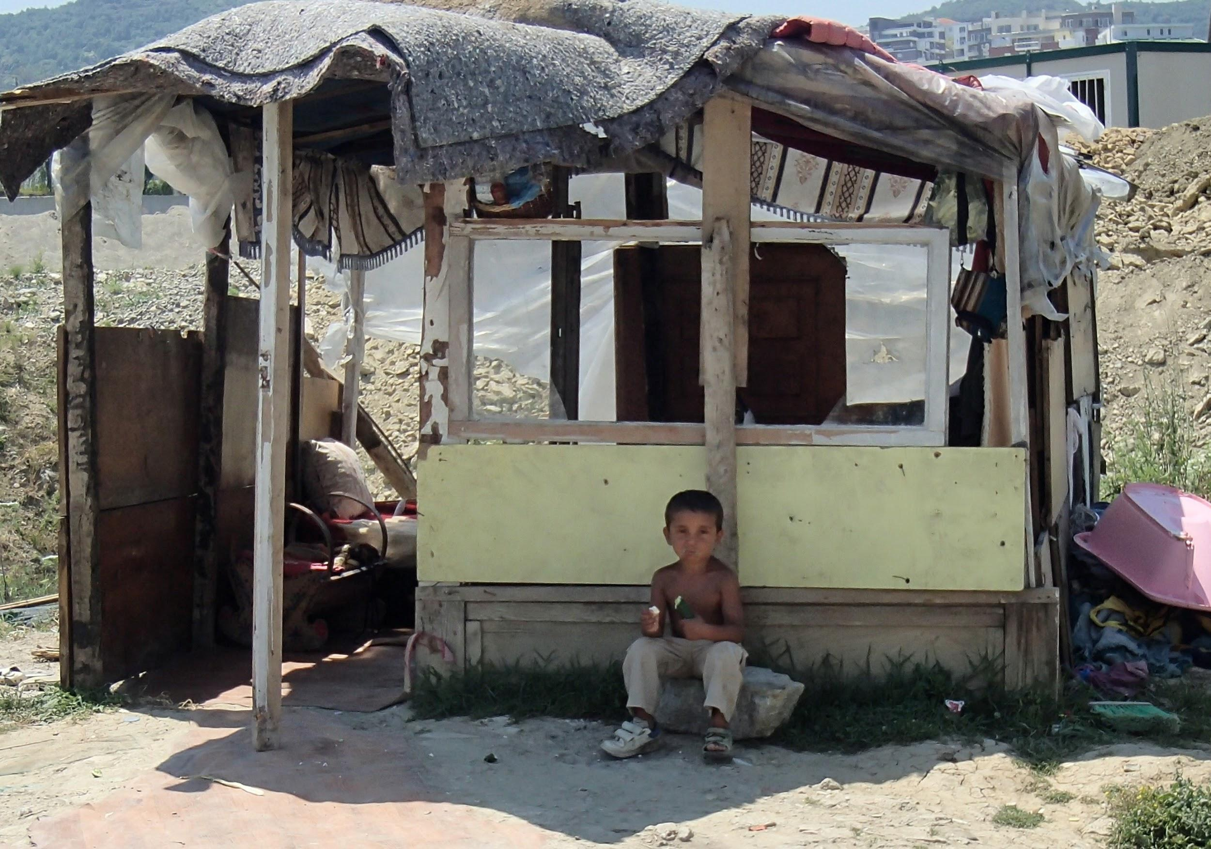
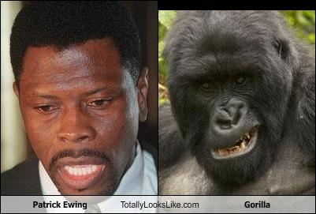
Struggle at Workplace

Slide 6
Job Characteristics
Minimum or below minimum payment
Have to work on position that require very strong health (such as cleaner, construction worker, load and unload cargo…)
Very few people, can get themselves out of the situation, to become doctor, lawyer or engineering

Slide 7
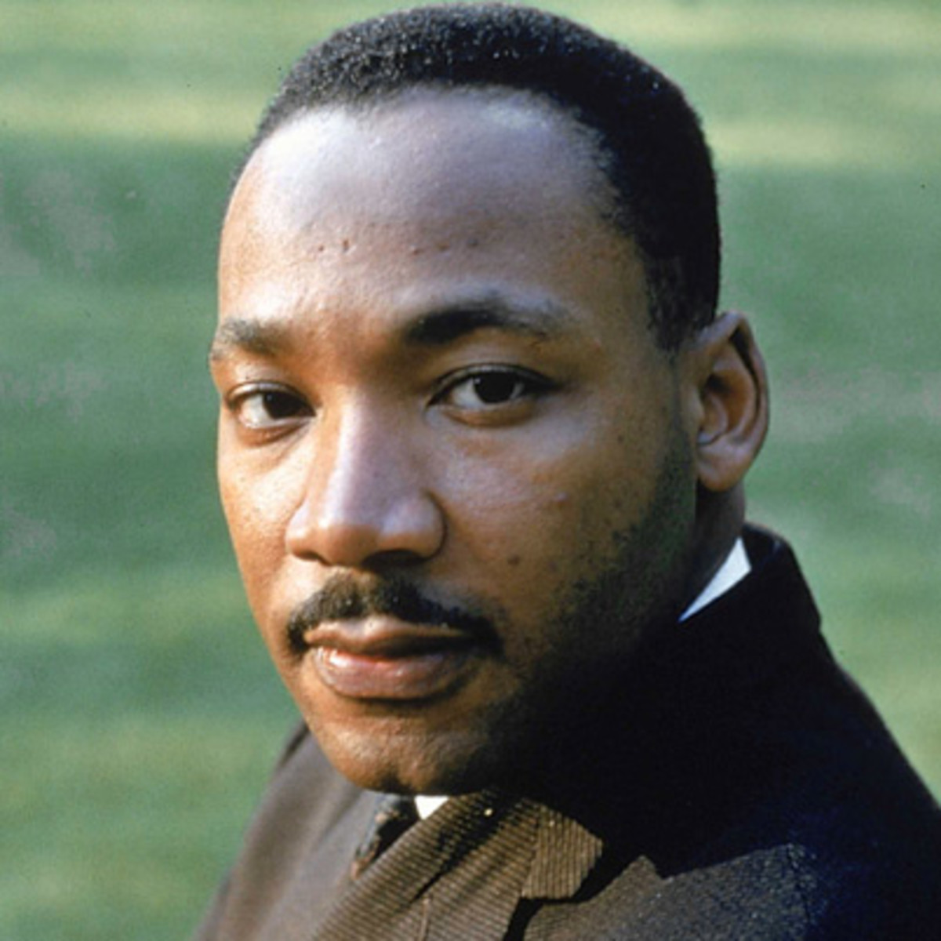
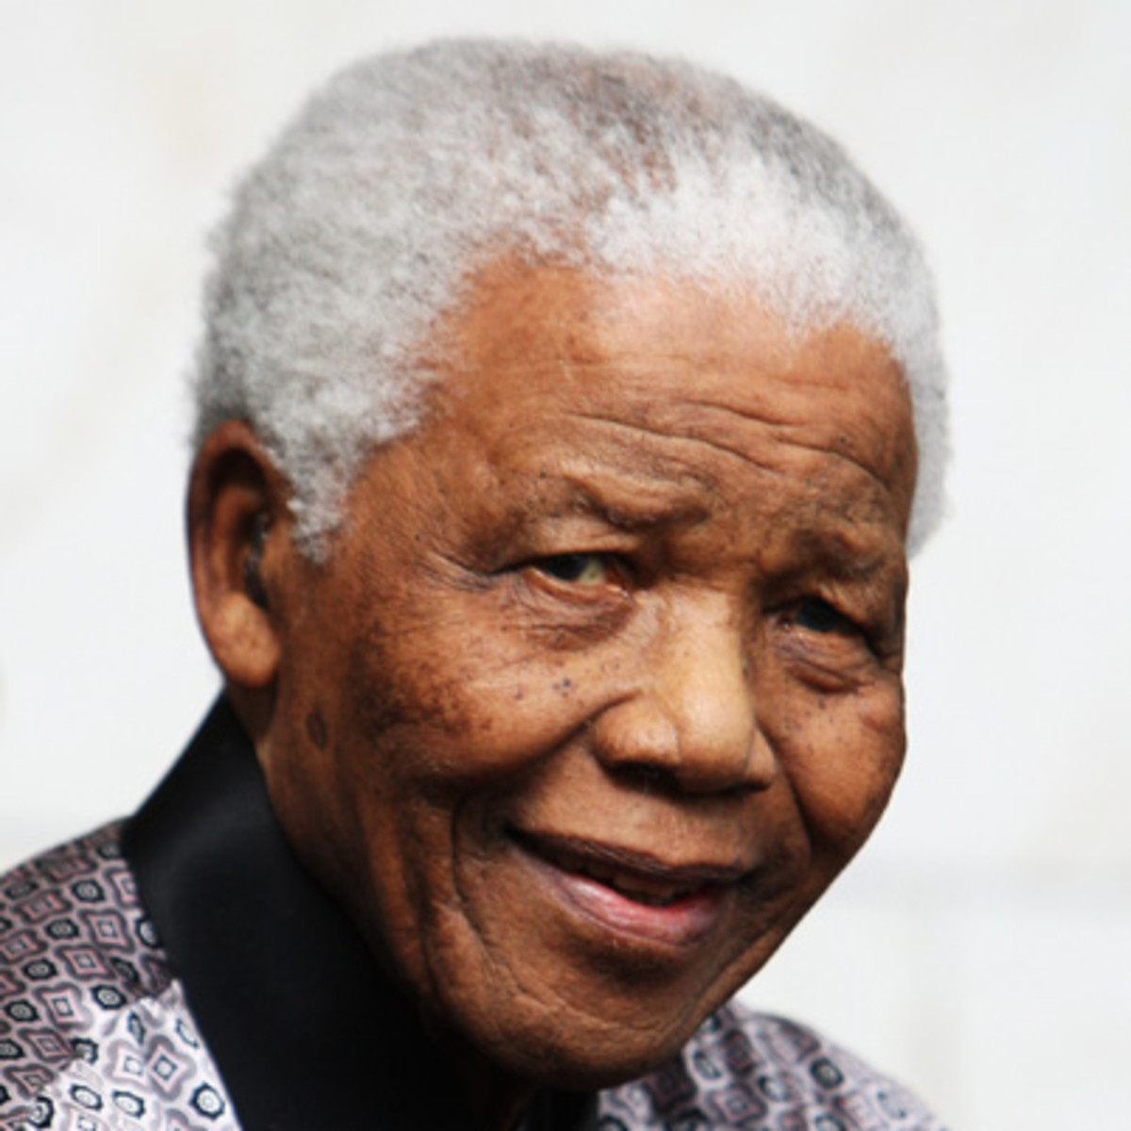
Recognition

